Slide 1
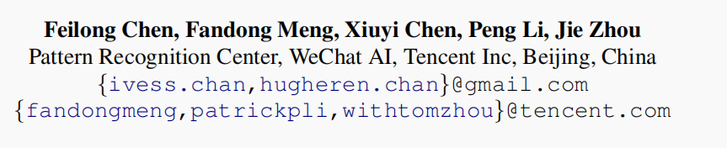





Multimodal Incremental Transformer with Visual Grounding for Visual Dialogue Generation
ACL-2021
Reported by Nengqiang Xiang, Dongdong Hu

Slide 2
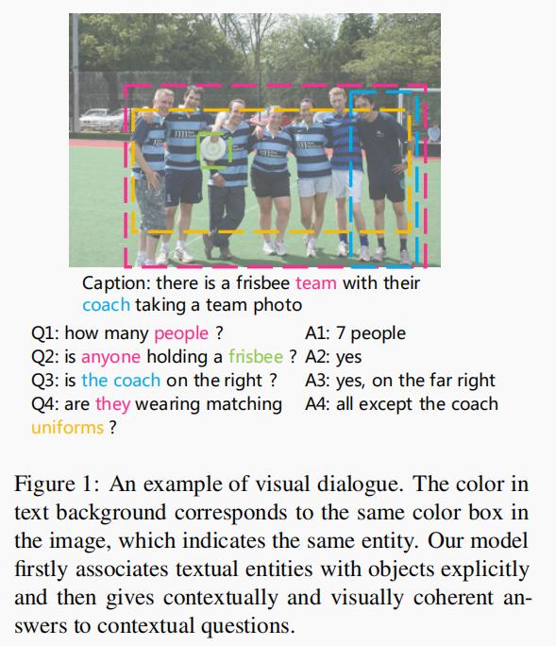
Introduction
Previous studies focus on the implicit exploration of multimodal co-reference by implicitly attending to spatial image features or object-level image features
but neglect the importance of locating the objects explicitly in the visual content, which is associated with entities in the textual content.

Slide 3
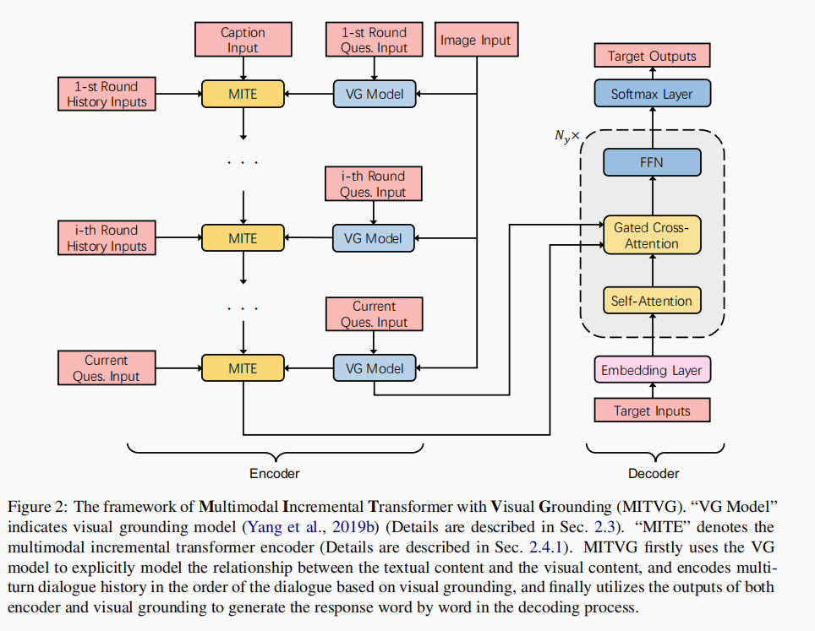
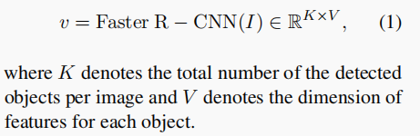

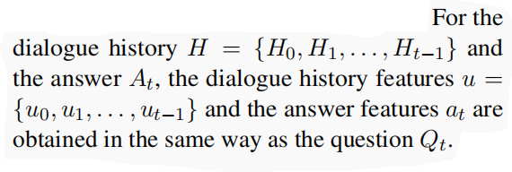
Method
Image Features
Language Features.

Slide 4
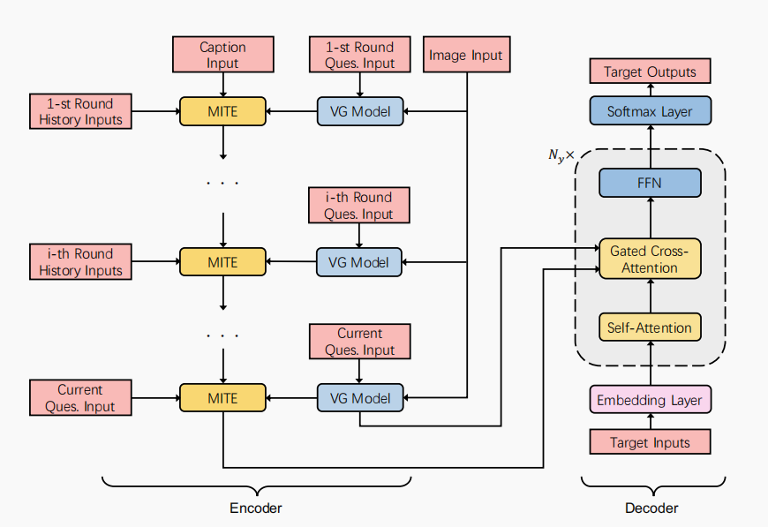

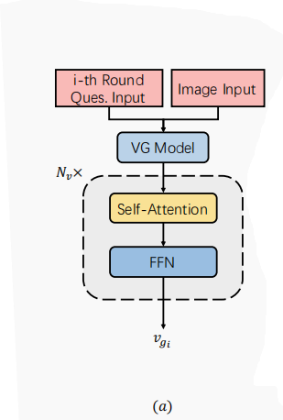




Method
Visual Grounding

Slide 5
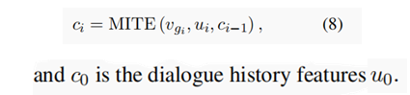
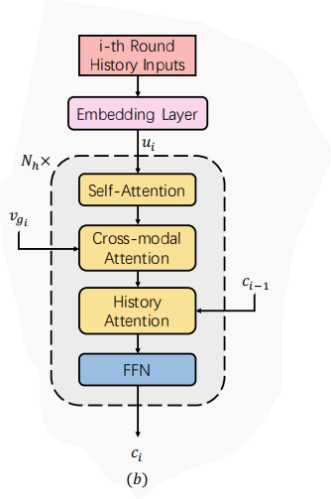

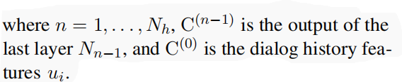





Method
MITE
Notes:
feed forward neural network layer (FFNN)
multi-class是相对于binary二分类来说的，意思是需要分类的东西不止有两个类别
multi-label是说一个sample的标签不知有一个。

Slide 6
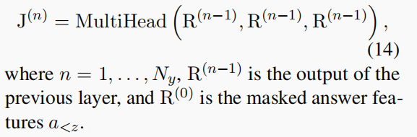
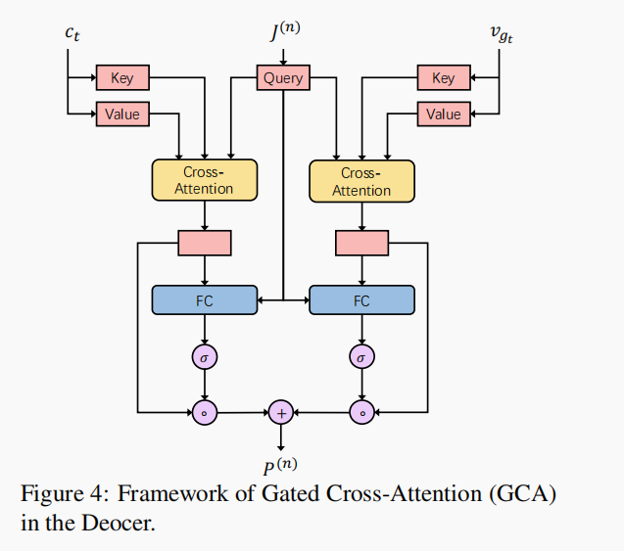
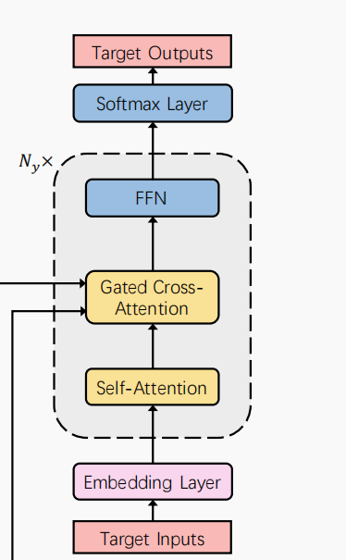
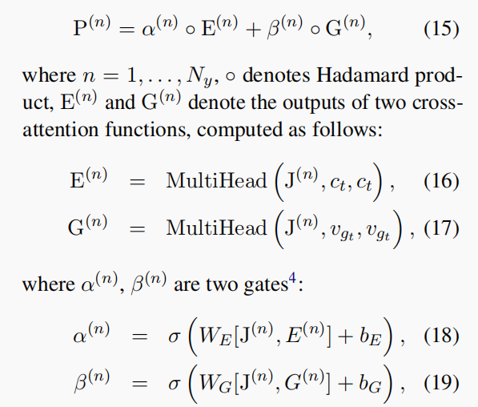
Method
Gated Cross-Attention Decoder(GCAD)
Notes:
feed forward neural network layer (FFNN)
multi-class是相对于binary二分类来说的，意思是需要分类的东西不止有两个类别
multi-label是说一个sample的标签不知有一个。

Slide 7



Method
Gated Cross-Attention Decoder(GCAD)
Notes:
feed forward neural network layer (FFNN)
multi-class是相对于binary二分类来说的，意思是需要分类的东西不止有两个类别
multi-label是说一个sample的标签不知有一个。

Slide 8
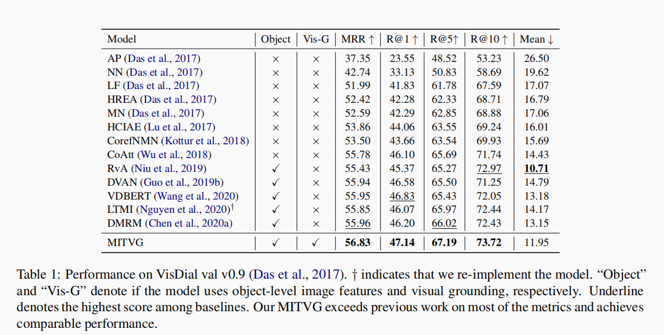
Experiments

Slide 9
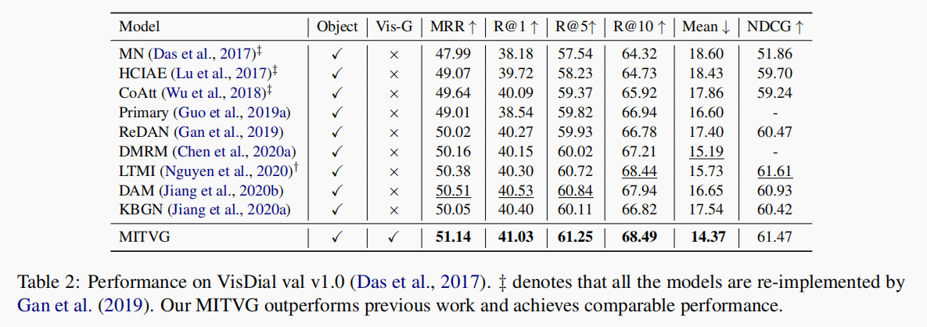
Experiments

Slide 10
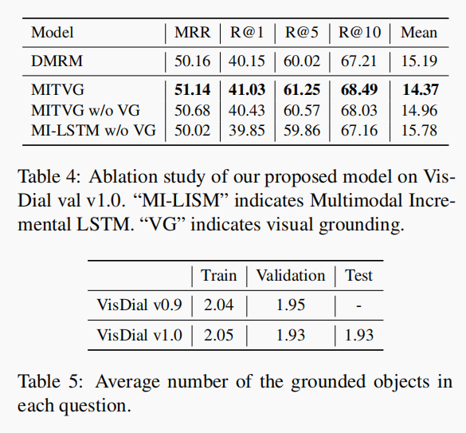
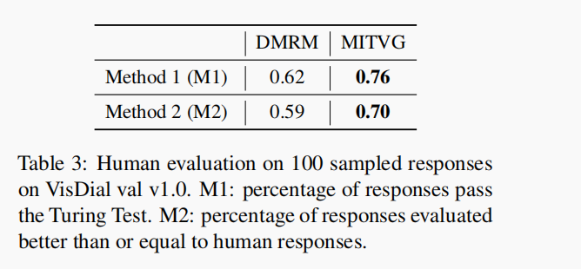
Experiments

Slide 11
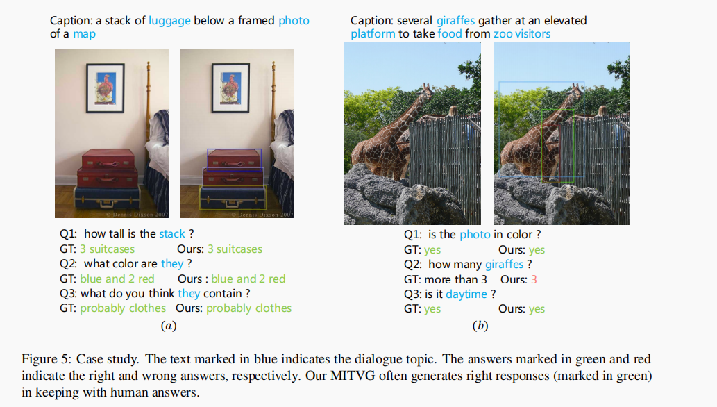
Experiments

Slide 12
Thanks

